Slide 1
第十六章 NAT
Notes:
Purpose: This chapter provides an overview of Network Address Translation (NAT) and Port Address Translation (PAT). It then discusses how to enable it on a Cisco router.
Timing: This chapter takes approximately 2 hours to present.
Note: This section has a laboratory exercise that allows students to enable NAT on a Cisco router.
Contents:
Objectives—This section explains what the student will be able to do at the end of this chapter.
NAT Overview—This section introduces students to NAT.
NAT Operation—This section describes how NAT works.
Configuring NAT—This section describes how to configure NAT on a Cisco IOS™ router.
Verifying and Troubleshooting NAT—This section describes how to verify NAT configuration.
Configuring and Troubleshooting PAT on the 700 Router—This section describes how to enable PAT on a 700 series Cisco router.
Laboratory Exercise—Students will configure NAT.
Summary—This section summarizes what was taught in the chapter.
Review Questions—This section offers open-ended review questions. They should foster discussion after presenting the chapter.
Transition: Following are the performance objectives that describe what students will be able to do at the end of the chapter.

Slide 2
NAT———网络地址翻译
随着Internet的飞速发展，网上丰富的资源产生着巨大的吸引力。
接入Internet成为当今信息业最为迫切的需求。
但这受到IP地址的许多限制。
首先，许多局域网在未联入Internet之前，就已经运行许多年了，局域网上有了许多现成的资源和应用程序，但它的IP地址分配不符合Internet的国际标准，因而需要重新分配局域网的IP地址，这无疑是劳神费时的工作
其二，随着Internet的膨胀式发展，其可用的IP地址越来越少，要想在ISP处申请一个新的IP地址已不是很容易的事了。

Slide 3
NAT
NAT（网络地址翻译）能解决不少令人头疼的问题。
它解决问题的办法是：在内部网络中使用内部地址，通过NAT把内部地址翻译成合法的IP地址，在Internet上使用。
其具体的做法是把IP包内的地址池（内部本地）用合法的IP地址段（内部全局）来替换。

Slide 4


Chapter Activities
NAT table
Inside Local
Inside Global IP
IP Address
Address
PAT
10.1.1.1
192.168.2.2
Async
Central site
SA
10.1.1.1
AAA server
BRI
PRI
SA
Frame Relay
ISDN/analog
192.168.2.2
Windows 95 PC
Modem
Async
Frame Relay
service
Small office
BRI
Frame Relay
Branch office
Notes:
Purpose: This figure is a graphical illustration of the chapter objectives.

Slide 5
NAT 术语
NAT功能
NAT三种类型

Slide 6
NAT 术语
Inside
DA
192.168.2.2
B
Host B
DA
10.1.1.1
172.20.7.3
SA
192.168.2.2
C
Internet
10.1.1.2
SA
10.1.1.1
A
Simple NAT table
D
10.1.1.1
Inside Local IP
Inside Global
Address
IP Address
A
B
10.1.1.2
202.100.192.68
10.1.1.1
192.168.2.2
Notes:
inside local
inside global
outside local
outside global

Slide 7
内部本地地址:私有IP，不能直接用于互连网。
内部全局地址：用来代替内部本地IP地址的，对外，或在互联网上是合法的的IP地址。

Slide 8
复用内部的全局地址
将一个内部全局地址用于同时代表多个内部局部地址。
主要用IP地址和端口号的组合来唯一区分各个内部主机。
目前在公司内普遍应用。（如下图）

Slide 9
复用内部的全局地址
Inside
4
DA
192.168.2.2
5
Host B
10.1.1.3
3
172.20.7.3
DA
10.1.1.1
SA
192.168.2.2
4
Internet
DA
192.168.2.2
10.1.1.2
Host C
1
2
NAT table
172.21.7.3
SA
10.1.1.1
Protocol
Inside Local IP
Inside Global IP
Outside Global
10.1.1.1
Address: Port
Address: Port
IP Address: Port
10.1.1.1
TCP
10.1.1.3:1723
192.168.2.2:1492
172.21.7.3:23
TCP
10.1.1.2:1723
192.168.2.2:1723
172.21.7.3:23
TCP
10.1.1.1:1024
192.168.2.2:1024
172.20.7.3:23
Notes:
Purpose: This figure explains how overloading inside global addresses works.
Emphasize: Overloading inside global address translation is Port Address Translation (PAT). How to configure PAT on a Cisco 700 series router is described later in this chapter.
Transition: The next figure describes TCP load distribution.

Slide 10
NAT三种类型
NAT有三种类型：静态NAT，动态NAT 和端口NAT（PAT）。
其中静态NAT设置起来最为简单，内部网络中的每个主机都被永久映射成 外部网络中的某个合法的地址。
而动态NAT是在外部网络中定义了一系列的合法地址，采用动态分配的方法映射到内部网络。
PAT则是把内部地址映射到外部网络的一个IP地址的不同端口上。

Slide 11
Static NAT Configuration Example
ip nat inside source static 10.1.1.1 202.100.1.1
!
interface Ethernet0
ip address 10.1.1.10 255.255.255.0
ip nat inside
!
interface Serial0
ip address 172.16.2.1 255.255.255.0
ip nat outside
!
This interface connected to the inside network.
This interface connected to the outside world.
Maps the inside local address to the inside global address.
Notes:
Purpose: This figure displays the static NAT configuration output.
Emphasize: Highlight the inside and outside interfaces on this configuration.
Note: This figure and the subsequent NAT configuration figures only display the configurations necessary to configure NAT translation. Other commands may be necessary for routing.

Slide 12
Dynamic NAT Configuration
ip nat pool dyn-nat 202.168.2.1 202.168.2.254
netmask 255.255.255.0
ip nat inside source list 1 pool dyn-nat
!
interface Ethernet0
ip address 10.1.1.10 255.255.255.0
ip nat inside
!
interface Serial0
ip address 172.16.2.1 255.255.255.0
ip nat outside
!
access-list 1 permit 10.1.1.0 0.0.0.255
!
This interface connected to the inside network.
This interface connected to the outside world.
Translate between inside hosts addressed from 10.1.1.0/24 to
the globally unique 192.168.2.0/24 network.
Notes:
Purpose: This figure displays the dynamic NAT configuration output.

Slide 13
Configuring Inside Global Address Overloading
ip nat pool ovrld-nat 202.168.2.1 202.168.2.2
netmask 255.255.255.0
ip nat inside source list 1 pool ovrld-nat overload
!
interface Ethernet0/0
ip address 10.1.1.10 255.255.255.0
ip nat inside
!
interface Serial0/0
ip address 172.16.2.1 255.255.255.0
ip nat outside
!
access-list 1 permit 10.1.1.0 0.0.0.255
Notes:
Purpose: This figure describes how to configure inside global address overloading.

Slide 14
Verifying NAT
Basic IP address translation
Router#show ip nat trans
Pro Inside global Inside local Outside local Outside global
--- 192.2.2.1 10.1.1.1 --- ---
--- 192.2.2.2 10.1.1.2 --- ---
IP address translation with overloading
Router#sh ip nat trans
Pro Inside global Inside local Outside local Outside global
tcp 192.168.2.1:11003 10.1.1.1:11003 172.16.2.2:23 172.16.2.2:23
tcp 192.168.2.1:1067 10.1.1.1:1067 172.16.2.3:23 172.16.2.3:23
Unique TCP port numbers are used to distinguish
between hosts.
A translation for a Telnet is still active.
Two different inside hosts appear on the outside with a single IP address.
Notes:
Purpose: This figure describes how to verify your NAT configuration output.
Emphasize: The upper output box displays the typical NAT table. The lower output box displays the NAT table with overloading.
Note: When looking at the IP NAT translations, you may see many translations from the same host to the same host at the destination. This is typical of many connections to the Web.

Slide 15
IPv6高级特性
更大地址空间
  全球可达性
  支持地址聚合
  自动配置,即插即用
简化包头
  提高路由效率
  减少转发延迟
  无校验和
  无广播机制

Slide 16
IPv6高级特性(续)
移动性与安全性
  支持移动IP
  强制IPsec
IPv4与IPv6的过渡
  双栈
  6to4隧道
  地址转译

Slide 17
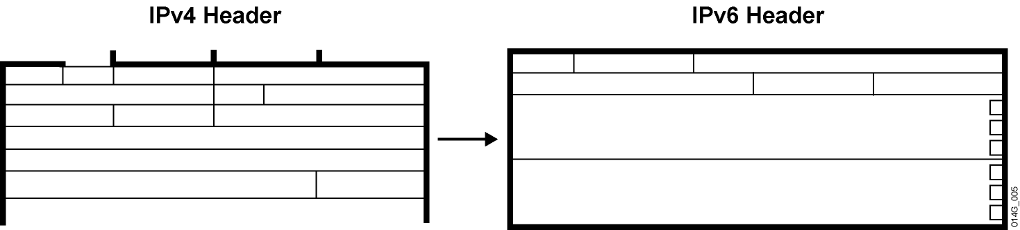
简化包头

Slide 18
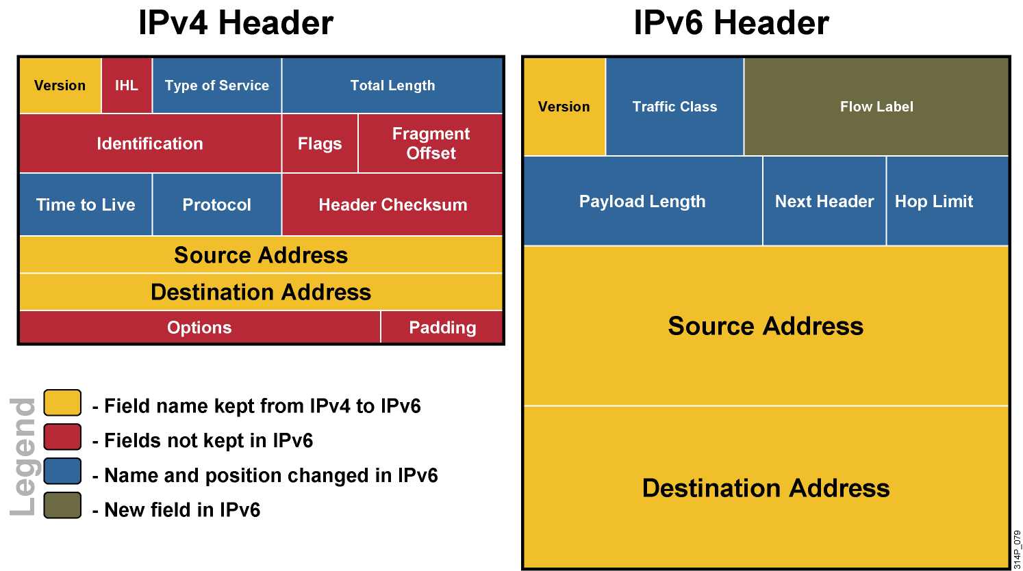
IPv4与IPv6包头对比

Slide 19
IPv6地址表示法
格式:
  x:x:x:x:x:x:x:x
    16进制,不区分大小写
  一个字段里全为0可以以一个0简写:
    2031:0:130F:0:0:9C0:876A:130B
  连续的0可以以::表示,但这种表示法只可以使用一次
  例如:
    2031:0000:130F:0000:0000:09C0:876A:130B
    2031:0:130f::9c0:876a:130b
    2031::130f::9c0:876a:130b—错误的表示法
    FF01:0:0:0:0:0:0:1 FF01::1
    0:0:0:0:0:0:0:1 ::1
    0:0:0:0:0:0:0:0 ::

